Slide 1
Introduction to Data science and Business Analytics

Slide 2
Why Business Analytics & what is BA
To manage business uncertainities and create wealth
Business enterprises relying on processes than personality
Business analytics provides insights from electronic data
Business analytics allows your business to make predictive analysis rather than reacting to changes in data. By carefully monitoring data and sharing information openly across your organization, you can take a data-driven approach to decision making

Slide 3
Business Challenges addressed by BA
Healthcare – Predict the outbreak of diseases, right treatment at right stage, AI devices
Insurance – recommend right plan for right customer
Banks – cross-sell, upsell, detect fraud
Education – Enrollment to right course
Manufacturing – product innovation, JIT
Retail & eCommerce – recommend right products, increase scale of operations
Telecom – balance traffic, maximise profit, churn
Marketing & Retail - understand customer behavior
Human Resources – allocate right person for right job, performance appraisal
Government Subsidies & Programs – maximise reach, minimize leakages
Defense & Space & Missile technologies – increase longevity of satellites, detect resources
Automobile – driverless cars, pollution reduction, safety
Transportation Services – manage traffic flow
Law enforcement – face recognition
Cinema – animation, movie translation to multi-languages
Home security – smart homes
Internet of Things – performance and accuracy

Slide 4
Growth of Digital Data
IDC predicts that the digital data that we create and consume will grow from around 40 zettabytes of data in 2019 to 175 zettabytes in 2025 – that is more than four times the amount of data produced in 2019
Google was said to process around 20 petabytes of data a day. Google processes more than 40,000 searches every second, or 3.5 billion searches a day.
1.5 billion people are active on Facebook every day. That’s one-fifth of the world’s population.
Two-thirds of the world’s population now own a mobile phone
In just one minute:
Twitter users sent 473,400 tweets
Snapchat users shared 2 million photos
Instagram users posted 49,380 pictures
LinkedIn gained 120 new users

Slide 5
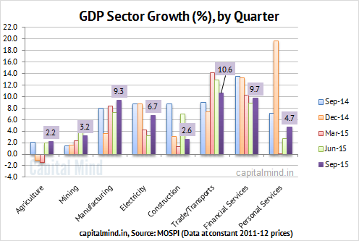
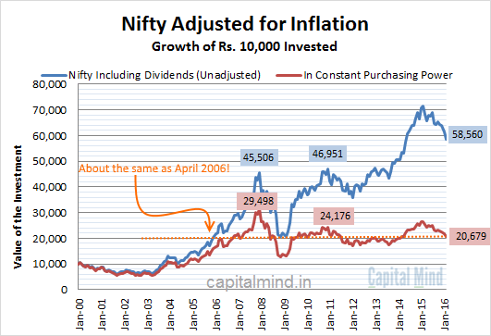
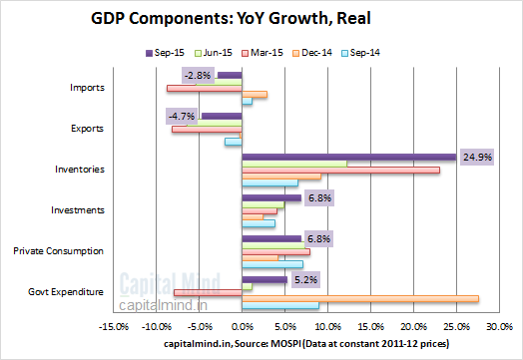
Activity: Analyse sales, profits and profitability across regions in global_superstore_2018 data

Slide 6
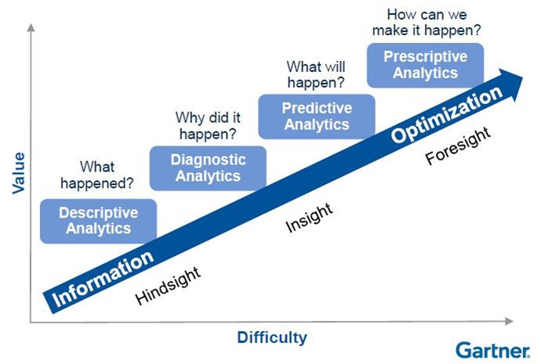
Stages of business analytics

Slide 7
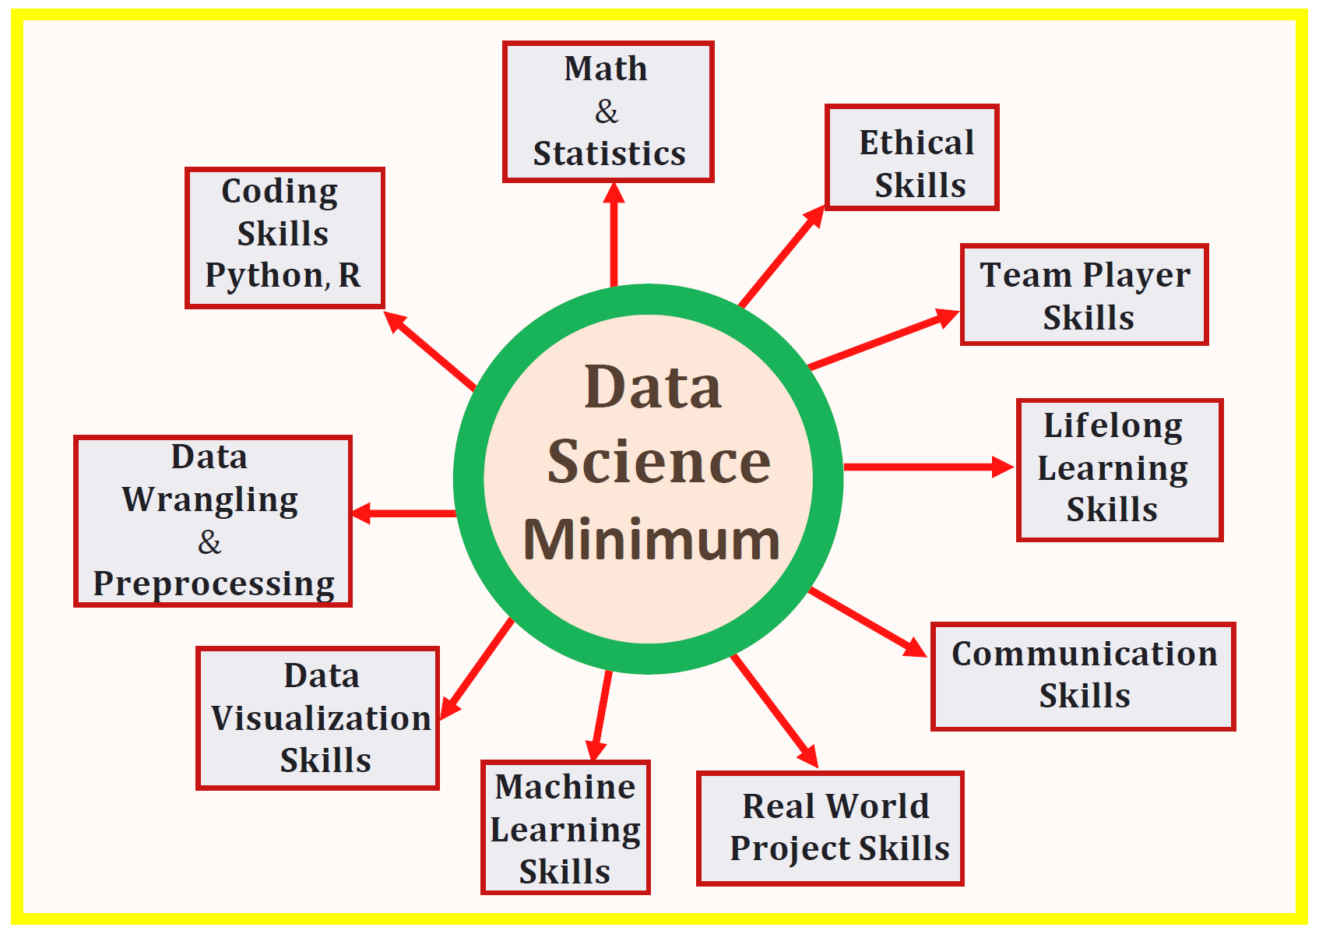
Data science skills

Slide 8
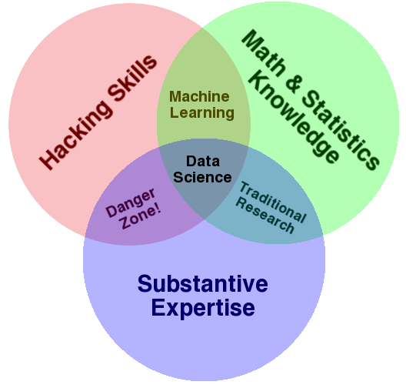
Data Science – A Definition
Data Science is the science which uses computer science, statistics and machine learning, visualization and human-computer interactions to collect, clean, integrate, analyze, visualize, interact with data to create data products.

Slide 9
Data Sciences’ Value Chain
Data Capture
Data Mgt
Data Storage
& Access
Analytics
Application
Evaluation
Transactions
Social Media
Stream Data
Environmental
Industrial
GPS
Image/Video
Exhaust Data
Network data
System logs
High rate financial data

Slide 10
Data Sciences’ Process Model
Data Capture
Data Mgt
Data Storage
& Access
Analytics
Application
Evaluation
Integration
Security
LCM
MDM
Data Quality

Slide 11
Data Sciences’ Process Model
Data Capture
Data Mgt
Data Storage
& Access
Analytics
Application
Evaluation
Hadoop HDFS
Map Reduce
DWH
Federated Discovery & Navigation

Slide 12
Data Sciences’ Process Model
Data Capture
Data Mgt
Data Storage
& Access
Analytics
Application
Evaluation
Descriptive Analytics
Association Rules
Sequence Rules
Segmentation
Predictive Analytics
Regression
Classification
Decision Trees
Neural Networks
Text Analytics
Real time Analytics

Slide 13
Data Sciences’ Process Model
Data Capture
Data Mgt
Data Storage
& Access
Analytics
Application
Evaluation
Discussion of Insights with domain experts;
Running experiments at scale;
Operationalising the Models;
ROI calculations
Business Case Development
Implementation Issues;

Slide 14
Data Sciences’ Process Model
Data Capture
Data Mgt
Data Storage
& Access
Analytics
Application
Evaluation
Monitoring;
Model Optimisation;
Evaluation of initiative

Slide 15
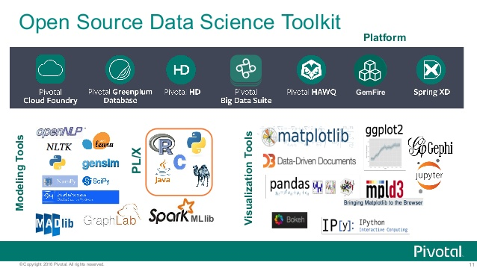
Notes:
CASP - Critical Assessment of protein Structure Prediction

Slide 16
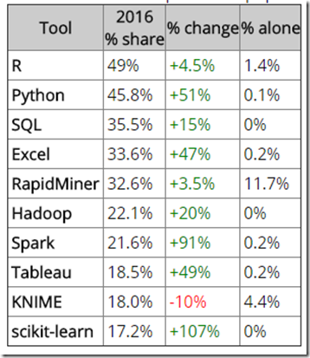
Notes:
CASP - Critical Assessment of protein Structure Prediction

Slide 17
Python for Data Science
Introduction to anaconda
Keyword and identifiers-.).
Comments, identations and statements-hash(#), indentation: and multiline statements’’’
Variables and data types in python
Standard input and output
Operators
Control flows: conditional statements
Control flow: loops
Control flow: break and continue

Slide 18
Python for Data Science
Introduction to anaconda
Keyword and identifiers
Comments, identations and statements
Variables and data types in python
Standard input and output
Operators
Control flows: conditional statements
Control flow: loops
Control flow: break and continue
Data structures – lists, tuples, sets, dictionary, strings
Functions, types, recursive, lambda
Modules, packages, exception handling, debugging,
Numpy, pandas, data frames, key operations on df

Slide 19
Keywords and identifiers
keywords (reserved words in Python);
keywords are case sensitive
There are 33 keywords in Python 3.7 FALSE and, as, assert, break, class, continue, def, del, elif, else, except, finally, for, from, global, if, import, in, is, lambda, None, nonlocal, not, or, Pass, raise, return, Try, while, with, yield, TRUE
identifiers (names given to variables, functions, etc
An identifier in Python must satisfy the following three conditions:
It must start with a letter (A-Z, a-z) or the underscore character (_).
It must consist of only letters (A-Z, a-z), digits (0-9), and the underscore character (_).
It must not be a keyword or reserved word such as while, which has a special meaning in Python.
All identifiers, indeed everything in Python, are case- sensitive:
 Num1 and num1 are thus two distinct identifiers representing two distinct variables (or functions).

Slide 20
Variables and data types
Variables are set with specific values via the assignment operation.
 Good practice to use meaningful variable names.
 In Python convention, identifier uses lowercase letters and words are separated with “_”
 e.g. sum, total_sum, age
The assignment operator = is used to assign a literal value or a value of another variable to a variable.
 Assignment statement: VARIABLE1 = VALUE VARIABLE2 = VARIABLE1
Data types: Integer, Float, String(Text), Boolean(T/F)

